Slide 1


Bellevue University DSC 630: Predictive Analytics Prof. Fadi Alsaleem
Astrid Fuentes
August 12th, 2021

Slide 2
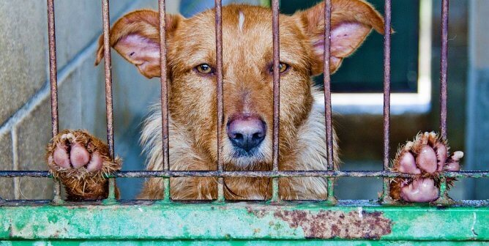
Introduction
Survive vs. Not Survive?
Breed, color, race, age
Health conditions
Aggressiveness
Other variables?
What can we do to help?

Slide 3
Methods
Logistic regression model based on determining characteristics of cats and dogs that will help predict whether the animal will survive the shelter or not.
Variables: age, color, health condition, and others.
Data: Austin Animal Center from October 1st, 2013 to March, 2016.
Software: Python and R

Slide 4
Risks
Data is limited to one shelter.
Other variables might be needed.
Failure in prediction could affect animal’s outcome.

Slide 5
Initial Analysis
Survived
Adopted
Transferred
Foster Care
Returned to Owner
Not Survived
Died
Euthanasia

Slide 6
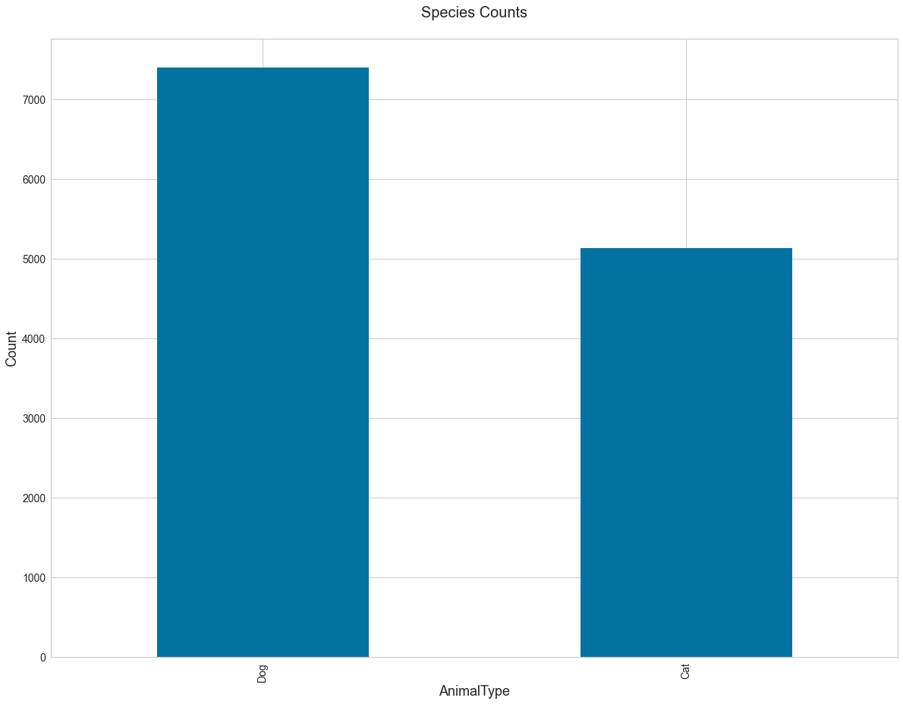
Animal Type
My initial analysis is based on exploration of the data. My data file contains 10 variables and 12521 records which represent one animal each. The animal type is divided in two major species: Cats and Dogs. There are 7392 dogs and 5129 cats in total.

Slide 7
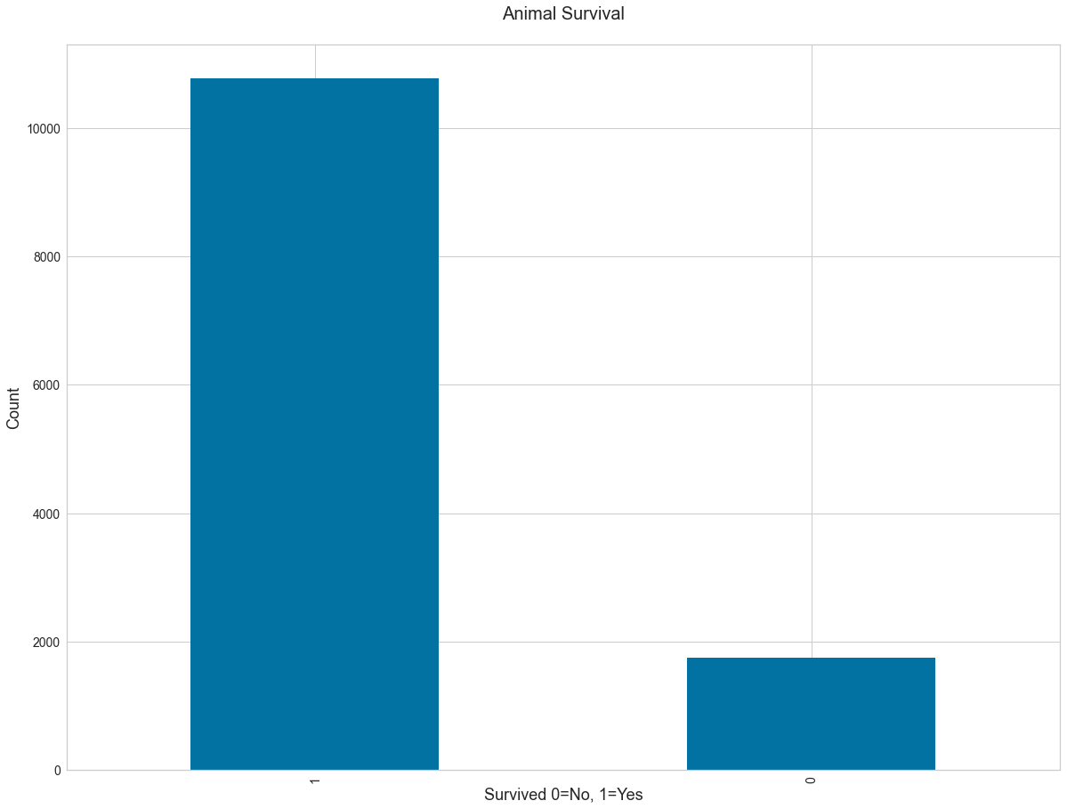
Outcome (Survival)
The outcome is also two groups: Survived (1) or Died (0). The number of animals who survived is considerably larger, 10769 animals versus 1752 animals that did not survive.

Slide 8
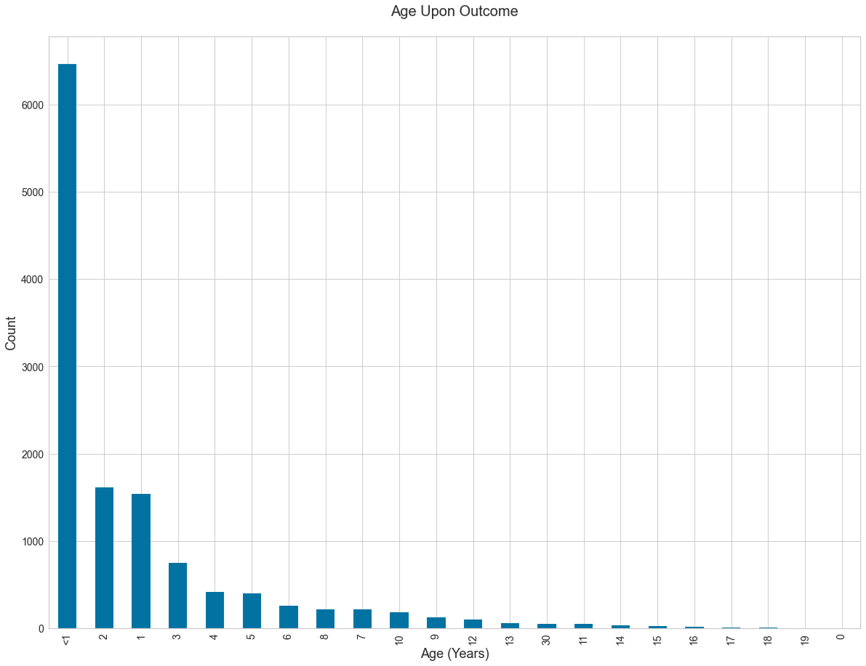
Age Upon Outcome
Most of the animals were under 1 year of age. This variable was recoded from the original file and contains values anywhere from 1 day to several weeks and up to 11 months. We can clearly see that older animals were less frequently seen at the shelter.

Slide 9
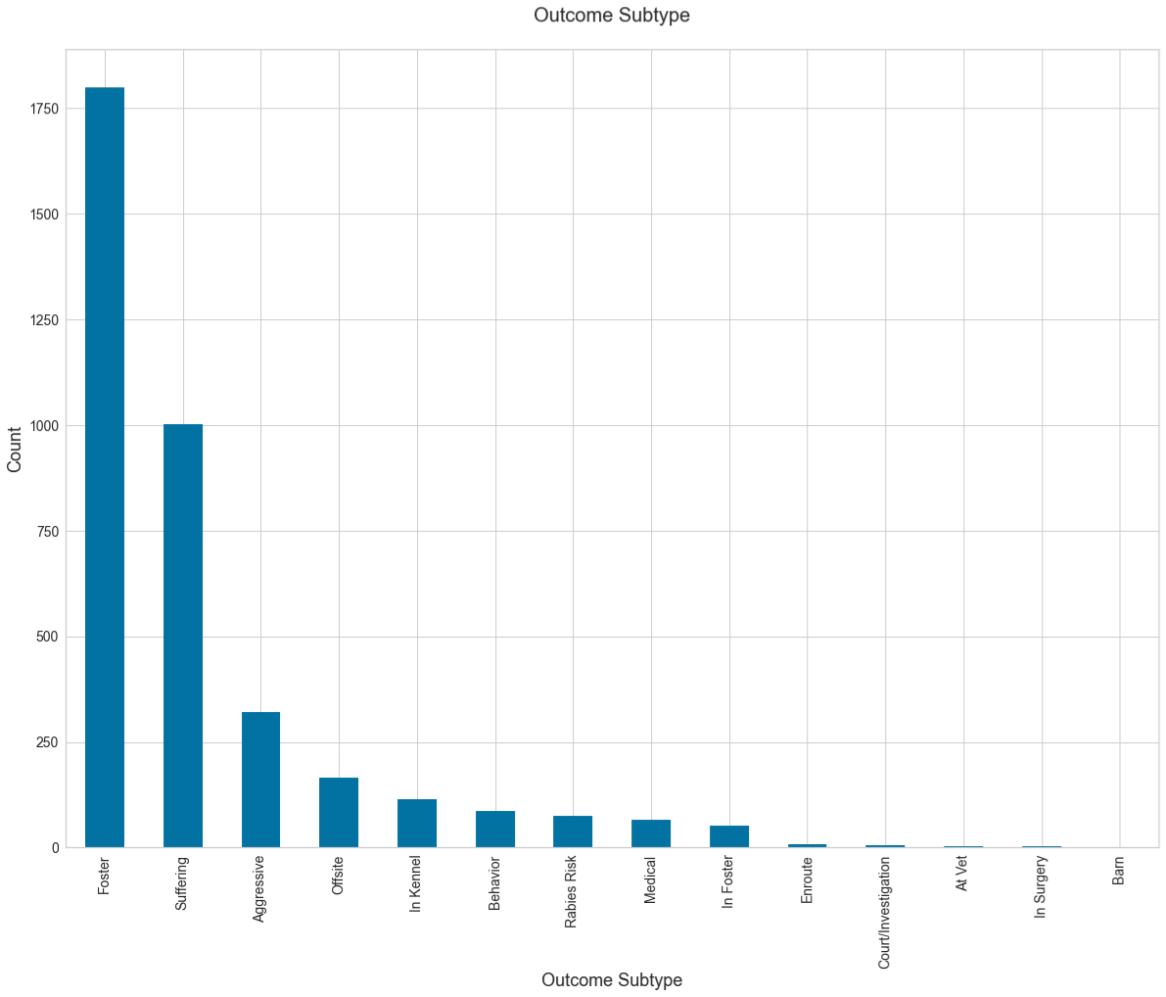
Type of Outcome
The Outcome Subtype variable contains a more specific reason for the outcome. The plot below combines survival and non-survival outcomes. Most of the animals who survived when to foster care while most of the animals who did not survive were euthanized due to suffering or aggressive behavior.

Slide 10
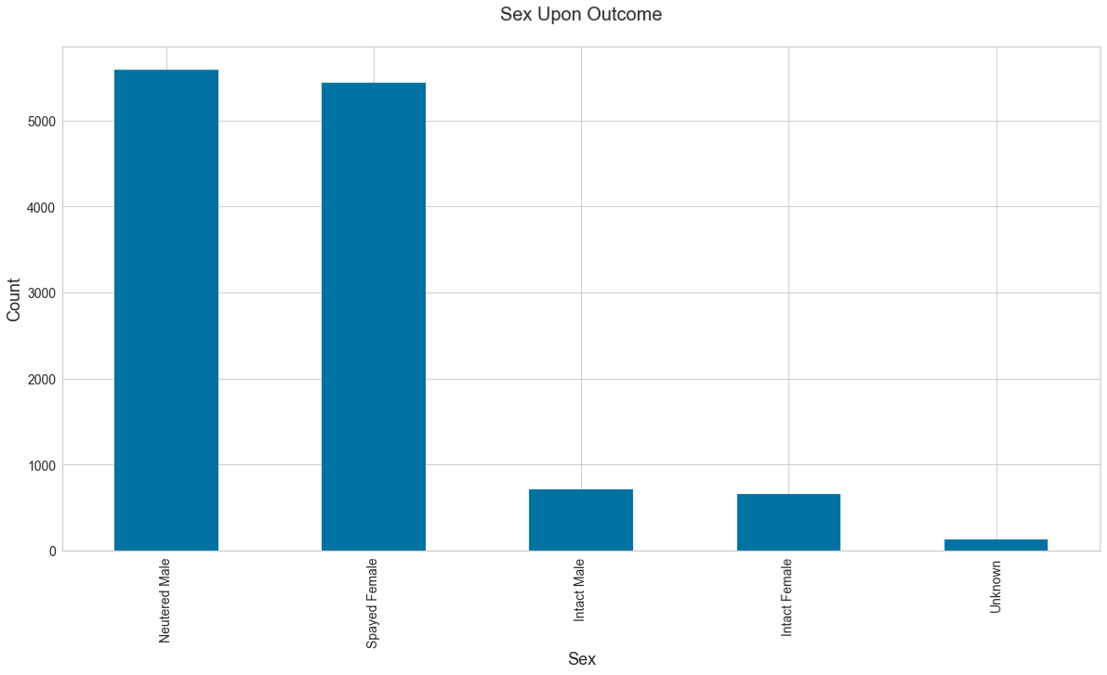
Sex upon Outcome
This plot shows that most cats and dogs were neutered or spayed upon outcome. Under 1000 males and 1000 females were intact, most likely under the age/weight requirement for surgery.

Slide 11
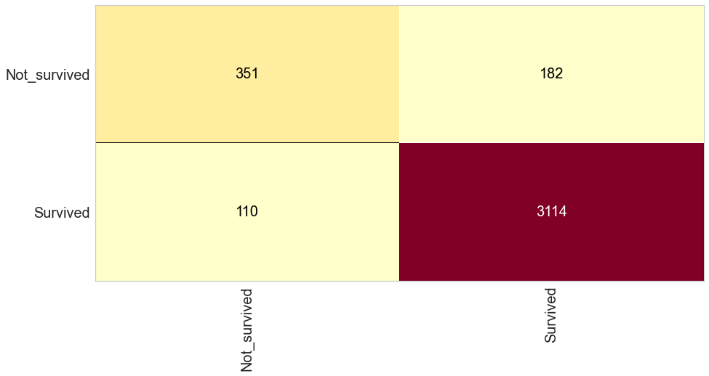
Model
Using a logistic regression classifier model and sklearn in Python I was able to predict the survival of the animals. Here is the confusion matrix associated with my model. It correctly predicted the survival of 3114 animals and the non-survival of 351 animals. The model incorrectly predicted the outcome of 292 animals. This model has an accuracy of 92.2%.
The model was built to predict Outcome Type (survived or not) using Age and the categorical dummy variables of Sex, Animal Type, Breed, and Color.

Slide 12
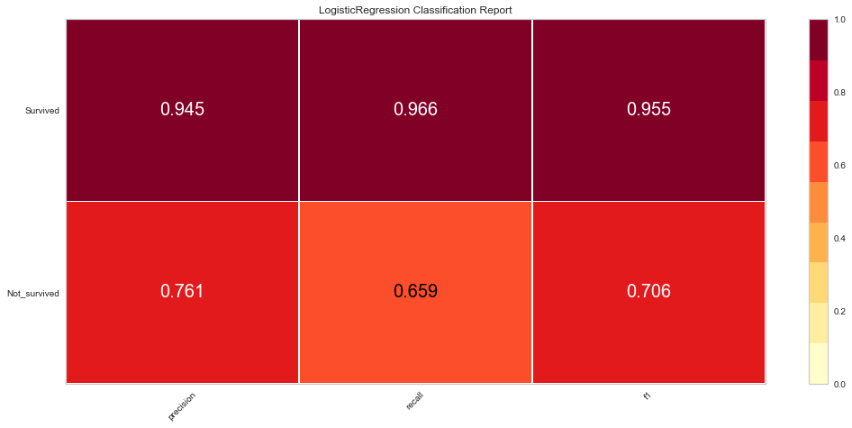
Model Accuracy
The model performed better at predicting the survivals with an accuracy of 94.5% while the non-survivals were predicted with a precision of 76.1%.

Slide 13
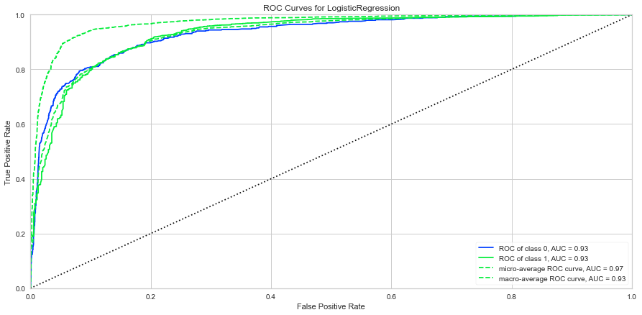
ROC Curves
The ROC curves are far away from the diagonal which indicates the model is accurate at predicting true positives.

Slide 14
Results
16% of the cats and dogs that enter the shelter do not survive.
Of those who do not survive, the majority are euthanized due to suffering or aggressive behavior.
Useful variables in predicting survival rate are Age, Sex, Animal Type, Breed, and Color.

Slide 15
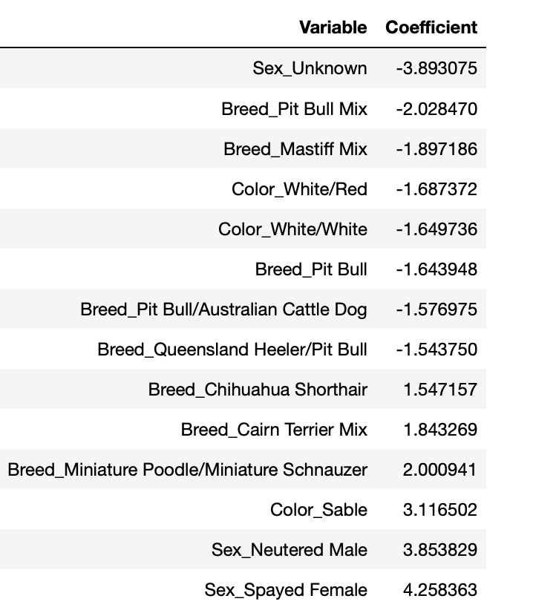
Results
Variable and Characteristic with higher contributions
Pitbull breeds
Color
Sex

Slide 16
Discussion/Conclusion
Additional Analysis
Improve veterinary care
Special adoption events
Incentives for adoption

Slide 17
References
https://www.kaggle.com/c/shelter-animal-outcomes/data?select=train.csv.gz
Eberly College of Science. Penn State University. Logistic Regression. https://online.stat.psu.edu/stat501/lesson/15/15.1
Li Susan, September 28, 2017. Building A Logistic Regression in Python, Step by Step. Towards Data Science. https://towardsdatascience.com/building-a-logistic-regression-in-python-step-by-step-becd4d56c9c8

